Slide 1


The State of Family Resilience in Europe Today: new evidence to support policy reform
rEUsilience Final Conference
27th June 2025
reusilience.eu
This project has received funding from the European Union’s Horizon Europe research and innovation programme under Grant Agreement No Project 101060410 and Innovate UK, the UK’s Innovation Agency.
Notes:
lay out specific evidence and policy recommendations, followed by an extended guided dialogue with participants designed to facilitate policy learning and to support informed policymaking

Slide 2
Closing the childcare gap
Ivana Dobrotić, University of Zagreb
Anna Matysiak, University of Warsaw

Slide 3
Childcare gap?
The disjuncture between the end of paid leave & access to affordable, high-quality childcare
‘A policy coordination failure’ (OECD, 2007, 2010; Eurofound, 2010)
A lack of complementarity & weak integration between parenting leaves & ECEC
Typically measured as a vacuum between the end of (well-paid) parenting leaves & the start of a legal entitlement to ECEC (Moss, 2011; Dobrotić, 2022)
  Well-paid leave? Legal entitlement to ECEC?
Allows to understand the context in which families make decisions & the extent to which families are forced to make trade-offs between work and care
Notes:
absence of formal support with childcare!); the acknowledgement of the interdependencies between policy domains vs a static understanding of policy
not merely a policy oversight or a technical policy failure

Slide 4
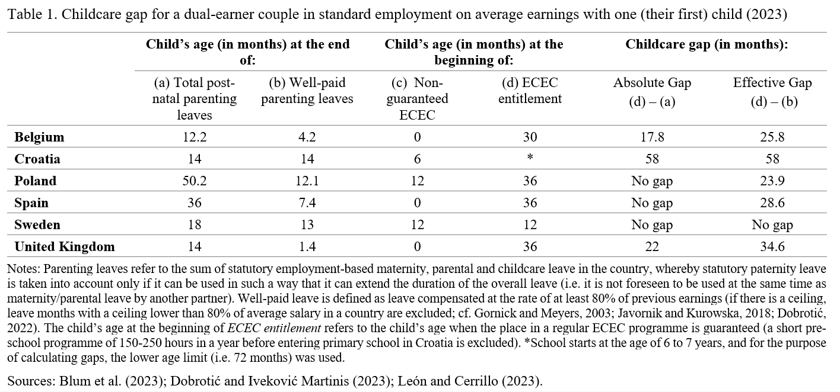
Source: Daly, Dobrotić & León (forthcoming)

Slide 5
Policy mechanisms producing the childcare gap?
(1) Parenting leaves design faced with many exclusions: various inequalities in statutory leave entitlements/systematic exclusion of some parents
Normative ideas about the ‘ideal’ caregiver & poor accommodation of policies to the lived experiences of diverse parents’ situations
Leave eligibility is shaped by a complex interplay of factors such as employment status (e.g. employee/self-employed/marginally employed), employment characteristics (e.g. contribution histories, employment sector, earnings/hours accumulated), legal residency or citizenship, family situation or sexual orientation (cf. Dobrotić & Blum, 2019; Kaufmann et al., 2022; Dobrotić & Iveković Martinis, 2023)
A weak recognition of family diversity within the leave design (e.g. lone parents, parents faced with disabilities/chronic illness, ‘larger’ families; Dobrotić & Iveković Martinis, 2023)

Slide 6
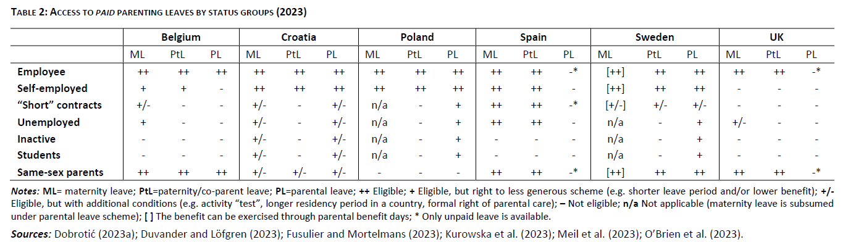
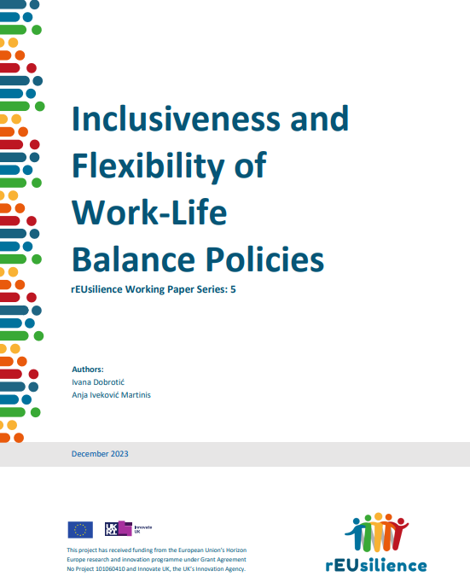
Source: Dobrotić & Iveković Martinis (2023)

Slide 7
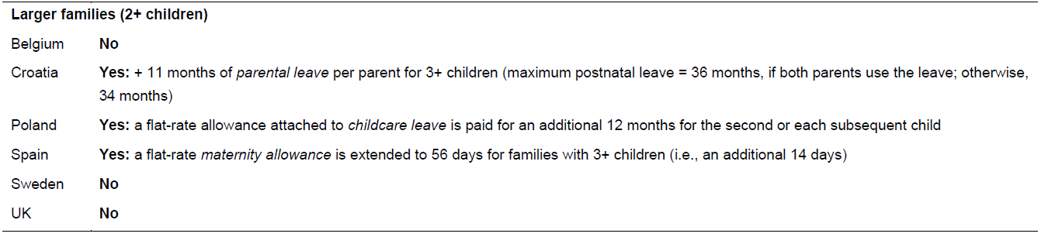
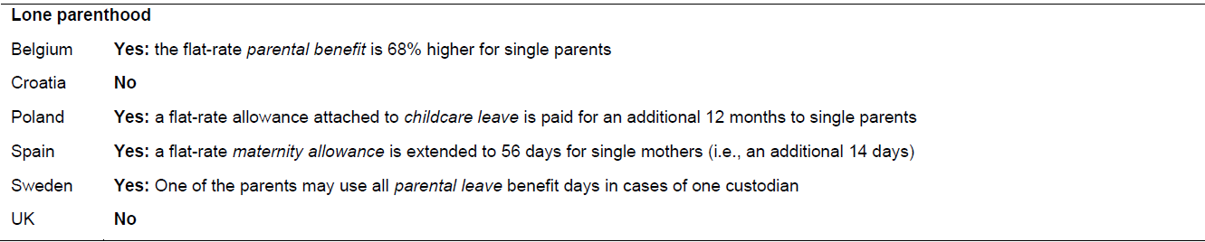
Source: Dobrotić & Iveković Martinis (2023)
Notes:
Sometimes mechanisms in place to mitigate CCG for families with xxx BUT
First, countries tend to provide these families with priority access to ECEC,
Second, additional leave provisions are also used to mitigate the gap. This is done through two main approaches: by extending the duration of leave (typically through extra paid days for eligible families), or by increasing the level of financial support during the leave period.

Slide 8
…
(2) Absence of well-paid leaves (e.g. low replacement rates, ceilings, flat-rate payments for parental leave, unpaid leaves)

Slide 9
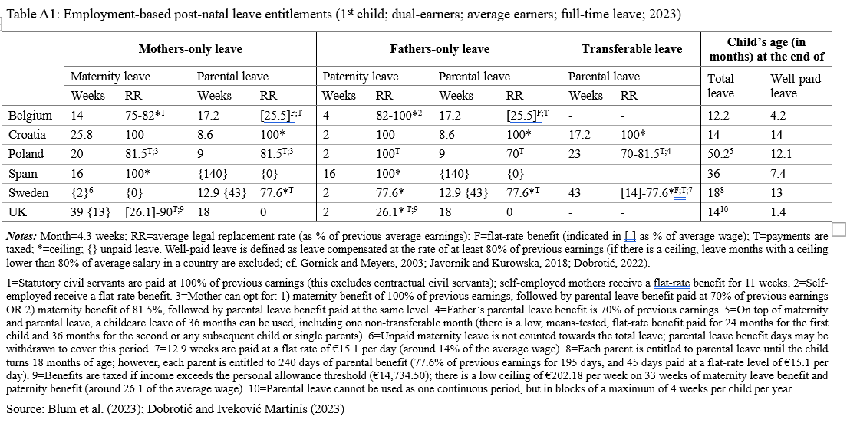

Slide 10
Policy mechanisms producing the childcare gap?
(1) Parenting leaves design faced with many exclusions: various inequalities in statutory leave entitlements/systematic exclusion of some parents
(2) Absence of well-paid leaves (e.g. ceilings, flat-rate payments for parental leave, unpaid leaves)
(3) Weak attention to legal entitlement to ECEC
+ In general, siloed policy making

Slide 11
Source: Daly, Dobrotić & León (forthcoming)

Slide 12
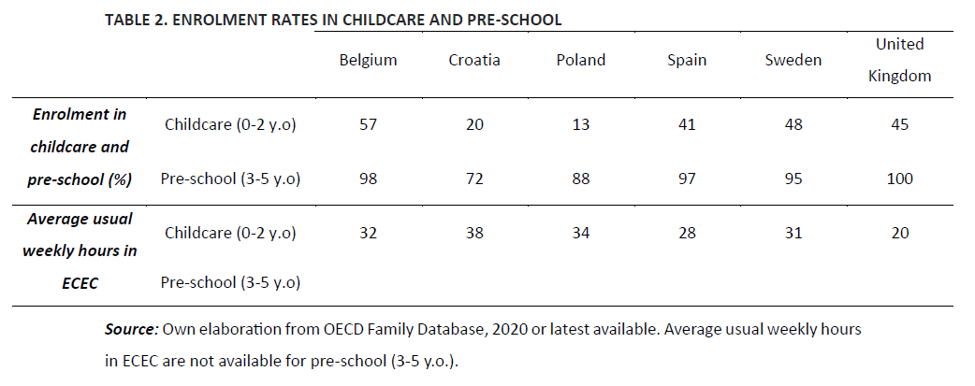
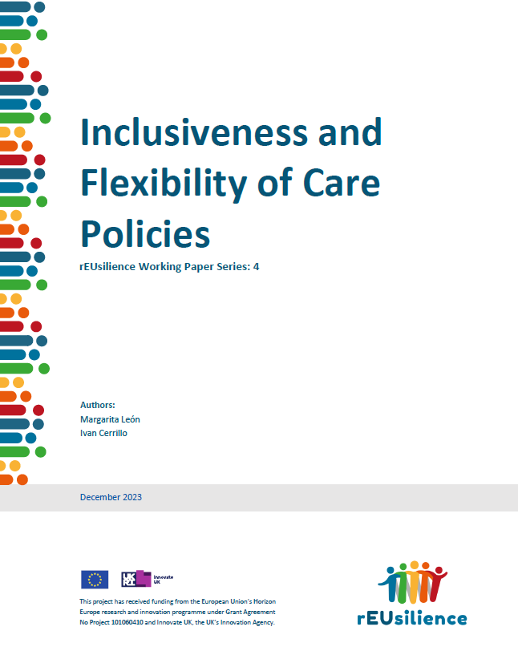
Source: León & Cerrillo (2023)

Slide 13
Some consequences of the childcare gap
(1) Labour force participation of women & gender equality
(2) Household budgets / poverty
(3) Inequalities in child outcomes
(4) Fertility

Slide 14
ECEC & mothers’ labour supply
Review of studies in high-income countries conducted between 1980-2016:
Public childcare services & subsidies generally increase women's employment, reduce the motherhood wage penalty, prolong mothers' working hours, and reduce occupational status penalty
Especially effective for mothers with low SES, though the effect is also present for highly educated women
Source: Ferragina E. Family policy and women's employment outcomes in 45 high-income countries: A systematic qualitative review of 238 comparative and national studies. Soc Policy Adm. 2020; 54: 1016–1066.

Slide 15
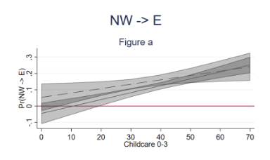
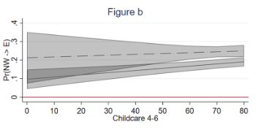
ECEC availability & mothers’ entry to employment
Source: Matysiak A, Kurowska A, Pavelea AM (2023) His unemployment, her response, and the moderating role of welfare policies in European countries. PLOS ONE 18(11): e0292749

Slide 16
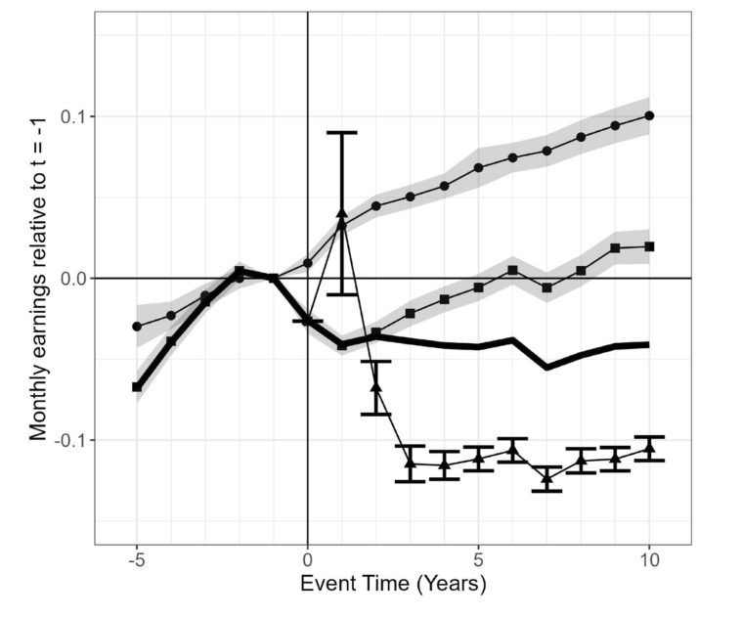
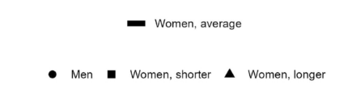
ECEC & gender inequality in earnings
than workplace average
Source: Österbacka, E., Räsänen, T. The Importance of Self-Selection and Childcare Leave Length for Child Penalty. Eur J Population 41, 3 (2025).

Slide 17
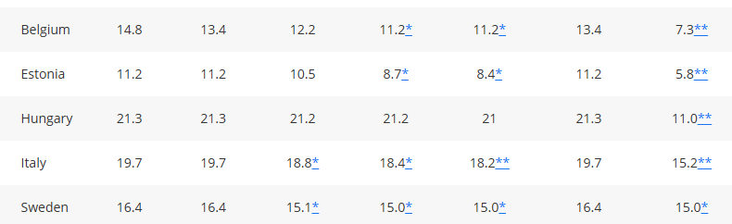
ECEC & poverty
Poverty rate among children <3 years
Childcare by 10 pp
Mothers empl by:
50% 70% 90%
Childcare for children under poverty line
Childcare by 10 pp
+ mothers in poverty start working
Baseline
Source: Hufkens, T., Figari, F., Vandelannoote, D., & Verbist, G. (2019). Investing in subsidized childcare to reduce poverty. Journal of European Social Policy, 30(3), 306-319

Slide 18
ECEC & child outcomes
Meta-analysis of 26 studies on universal childcare programs for children aged 0-6 versus a mix of parental, family and private modes of care (Dietrichson et al 2020)
  Mixed effects on health, well-being & behaviour
  Positive effects on primary & secondary school progression, years of schooling, highest degree completed, employment, and earnings
  More beneficial for children with low socioeconomic status (also Schmutz 2024)
Source: Dietrichson, Jens, Ida Lykke Kristiansen, and Bjørn A. Viinholt (2020) "Universal preschool programs and long‐term child outcomes: A systematic review." Journal of Economic Surveys 34: 1007-1043; Schmutz, R. (2024). Is universal early childhood education and care an equalizer? A systematic review and meta-analysis of evidence. Research in Social Stratification and Mobility, 89, 100859.

Slide 19
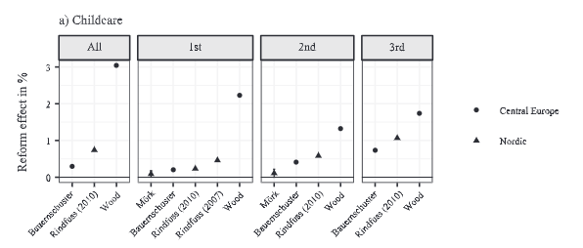
Childcare & fertility
Source: Bergsvik, J., Fauske, A. and Hart, R.K. (2021), Can Policies Stall the Fertility Fall? A Systematic Review of the (Quasi-) Experimental Literature. Population and Development Review, 47: 913-964.

Slide 20
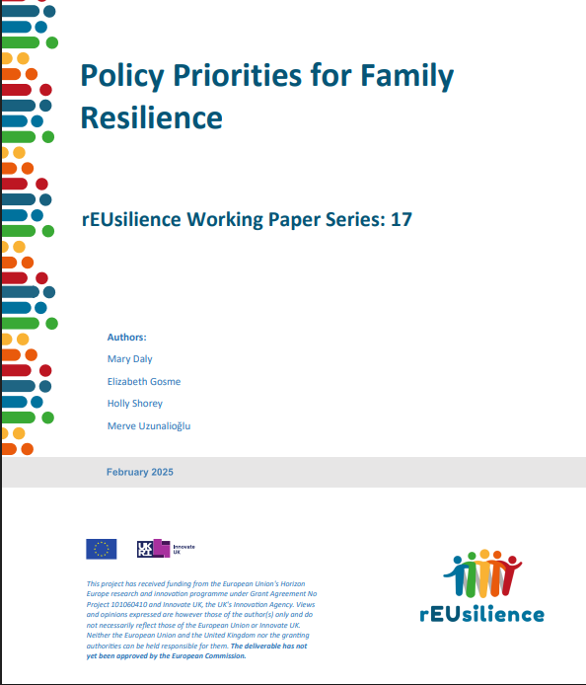
How to close the childcare gap?
A universal right to paid statutory parenting leaves
„It is emphasised that leave policy should be conceived from a wider perspective, not only as “employment policy – as job-protected entitlements to leaves from paid work for care work” (Doucet, 2021, 228), but as a right to care, providing time to care to all parents regardless of their position on, for example, the labour market or in the family.” (Dobrotić & Iveković Martinis, 2023)
All parents should be granted access to well-paid leave
All children should have a right to high-quality ECEC, with legal entitlement to ECEC being a crucial policy mechanism
Leave policy & ECEC designs should recognise & acknowledge the additional needs of some families

Slide 21
Some questions for discussion?
How is this relevant to your country or area of influence?
What can your country learn from these recommendations? Any others?
What can you do to support the take-up of these recommendations in your sphere of influence?

Slide 22
Questions?
Contact
ivana.dobrotic@pravo.hr
Ivana Dobrotić
University of Zagreb, Croatia
annamatysiak@uw.edu.pl
Anna Matysiak
University of Warsaw, Poland

Slide 23
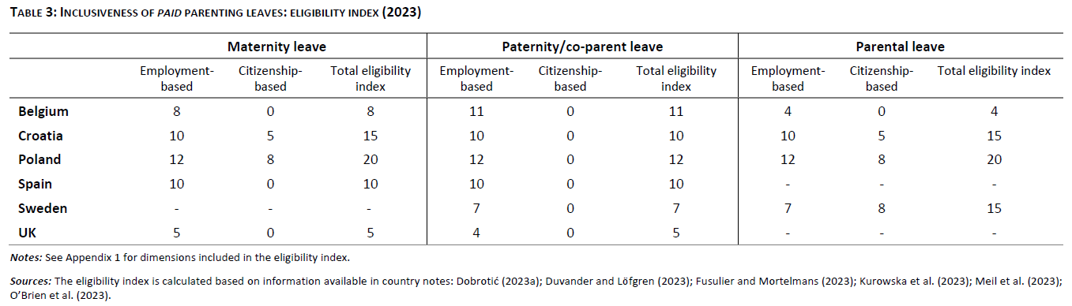
Source: Dobrotić & Iveković Martinis (2023)
Notes:
Backup slide for discussion

Slide 24
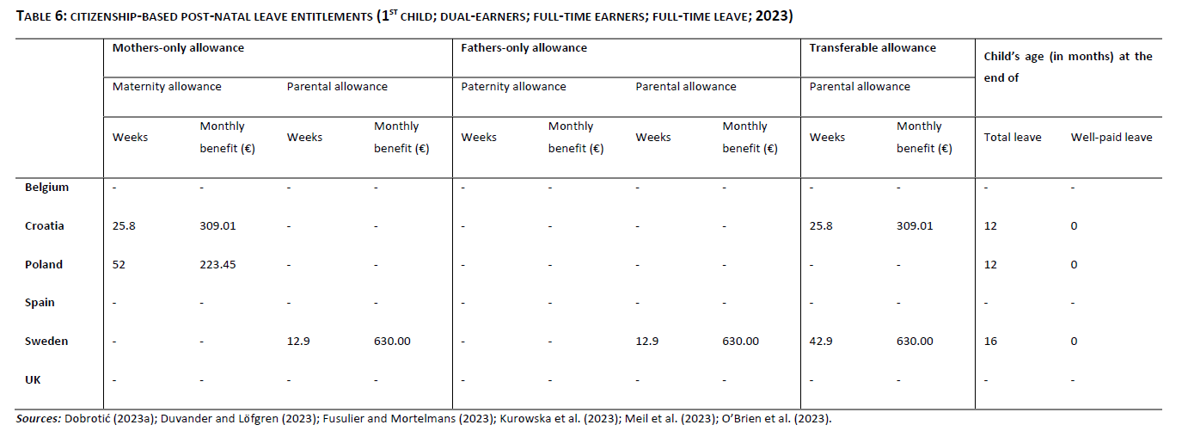
Source: Dobrotić & Iveković Martinis (2023)
Notes:
Backup slide for discussion

Slide 25
