Slide 1


Better income support for families with children with a particular concern for low-resourced families
Marga Léon and Wim Van Lancker
rEUsilience Final Conference
27th June 2025
reusilience.eu
This project has received funding from the European Union’s Horizon Europe research and innovation programme under Grant Agreement No Project 101060410 and Innovate UK, the UK’s Innovation Agency.

Slide 2
3 key concerns for rEUsilience:
(1) Degree of policy inclusiveness, flexibility and complementarity to cater for family diversity and greater complexity in family needs.
The capacity of Income protection to become buffers against family risks. Two main discussions:
(2) Universality vs Targeting in family/child benefits and social assistance
(3) Conditionality on Minimum Income Programmes (work first approach)

Slide 3
Beyond the ”typical family”
Families are exposed to different kind of risks
Family members can be a resource to buffer these risks; risks are increasingly complex
…but families also provide care within and beyond the household
Policies are resources that enable families to buffer risks

Slide 4
Universalism vs targeting
Universal policies are inclusive by default.
Means-testing and targeting likely to impose greater burden in application procedures (‘bureaucratic traps’ enhanced by digitalisation)
Significant ‘take up’ problems in targeted social policy
In under-resourced welfare states, targeting often underlines outsider/insider logics

Slide 5
Conditionality of Minimum Income Programmes
Focus on economic returns. Underlying assumption that these employment-oriented buffers create a virtuous cycle of wellbeing and labour market participation
This is problematic in a context of growing labour market dualization and precarious employment
Tends to weaken the ‘insurability’ capacity of benefits and risks subsidizing flexible, low-productivity employment
Exclusionary potential: those who cannot participate—due to disability, care responsibilities, or long-term unemployment are increasingly reliant on residual welfare programmes
Care demands are usually neglected and yet, care is a foundational component of social and economic life

Slide 6
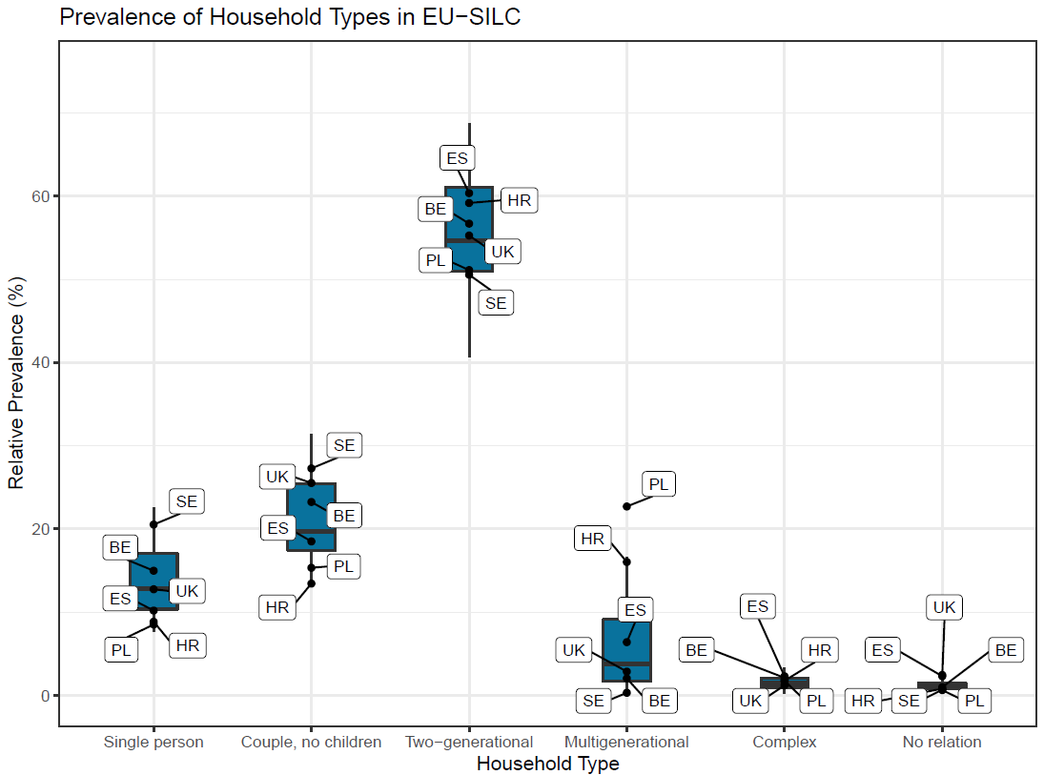

Slide 7
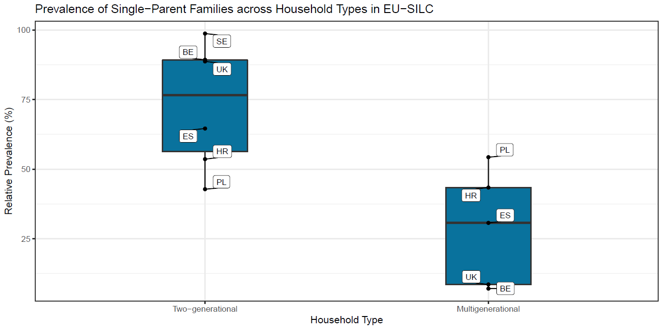

Slide 10
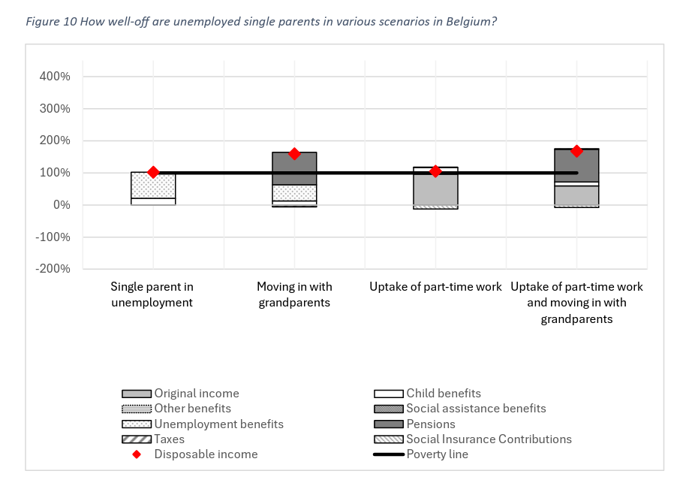
Strategies to buffer risks: the role of policies and family
The case of Belgium
Notes:
In Belgium (Figure 10), an unemployed single parent has a disposable income at the at-risk-ofpoverty level, and their income is a combination of unemployment benefits and child benefits (first column). If they were to live with grandparents (of their child(ren), and if the grandparents have an average pension, their income is substantially higher (second column). Only returning to employment part-time (column three) instead of cohabiting with grandparents, only marginally improves their income situation in relation to the baseline. In part this is because their labour income is only slightly higher than the unemployment benefits they now no longer receive, but also because they now need to pay social insurance contributions.

Slide 11
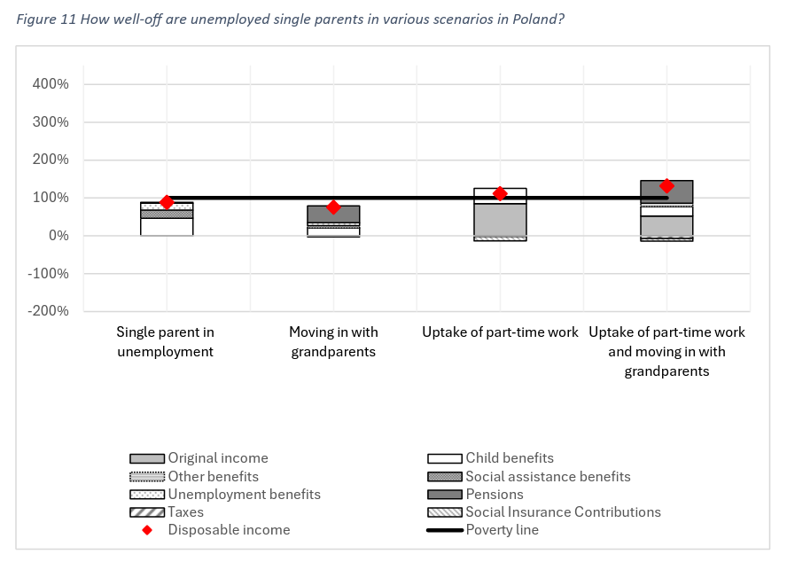
Strategies to buffer risks: the role of policies and family
The case of Poland
Notes:
In Poland (Figure 11), the situation is different. Here, single unemployment single parents are estimated to be in poverty. They receive more child benefits compared to in Belgium, and a social assistance top-up, but only very low unemployment benefits. Moving in with grandparents actually decreases their financial situation, because the social assistance top-up, the child benefit, and the unemployment benefits are all lower in that scenario.

Slide 12
How to improve income protection?

Slide 13
What works best in protecting families?
Given family diversity
Given different exposure to risks
Given existing policy designs
➔ Road testing child benefit and social assistance reforms
➔ An illustration for single adult and lone parent families

Slide 14
Road testing child benefit and social assistance reforms
Universal approach: a child benefit of €100 (PPP) per child
Modifier approach: increasing the existing child benefit system with 15%

Slide 15
Poverty reduction for families with children

Slide 16
Poverty reduction by family type

Slide 17
Principles for better income support for families with children
Given family diversity and labour market risks, going back to universality should be a leading principle driving income benefit reforms
Universality in the availability and coverage of child and family benefits can be combined with targeting of specific families with higher needs
Universality also tackles the care problem and enables work

Slide 18
Questions for discussion
How is this relevant to your country or area of influence?
What can your country learn from these recommendations?
What can you do to support the take up of these recommendations in your sphere of influence?

Slide 19
Questions?
Contact
Name Surname
Company name, Country

